Slide 1
Medfocus
Emergency Medical Healthcare app
by
Niranjan Bala
Venkat ramana
Prithvi
Vignesh Baalaji
Bharatvaj

Slide 2
Project Description
The idea involves the development of a mobile application that maintains a detailed medical record of the individual in the database,it also constantly keeps an eye on the individual’s vitals and health status , should it detect any abnormalities, it’ll send distress calls to the emergency contacts and contact the nearest medical facility and until then a chatbot will be programmed to assist the individual for any first-aid in case of injuries or any immediate measures to be taken in case of other medical emergencies.It also reminds the user to get his periodic health check-up incase if it exceeds the time period .It stores details about the user’s medical history,medication status , allergies etc. all of this which can be transferred to the attending doctor’s desk through file transfers via the app.The app will also be able to suggest the user some suitable medicines incase of any health deficits.

Slide 3
Key Functions
It constantly monitors the user’s health and vitals using iOS HealthKit sdk
Reports incase of any hike or drop in the vitals
Incase of any medical emergencies it immediately sends calls to emergency contacts, sends GPS position to ambulance and shares all the medical details of the patient with the attending doctor
It has a chatbot that can provide all kinds of medical assistance in the absence of a medical professional
It displays articles in the news feed related to the user’s illness or tips to cure certain disorders
It can set reminders for health check-ups and remind the user to get one if it has been a while since the last check-up
It also displays progress reports based on the medical records done in the previous months/years

Slide 4
App Modules
Database - NoSQL(Firebase)
HealthKit
User Interface
In-built camera of the iPhone

Slide 5
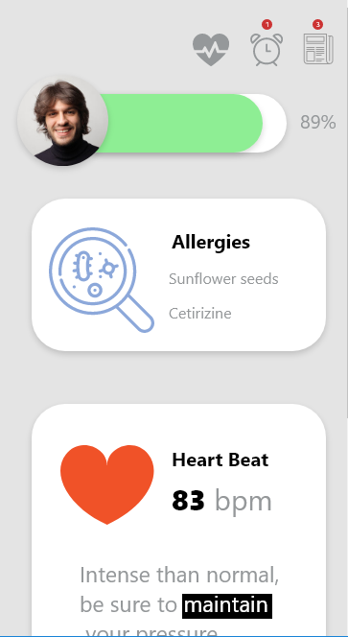
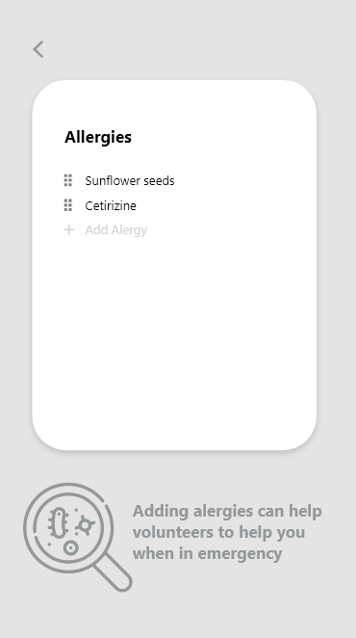
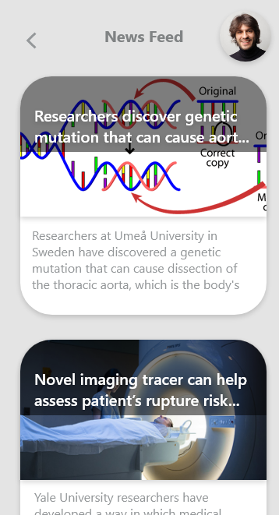
User Interface Flat design is adapted to improve User Experience

Slide 6
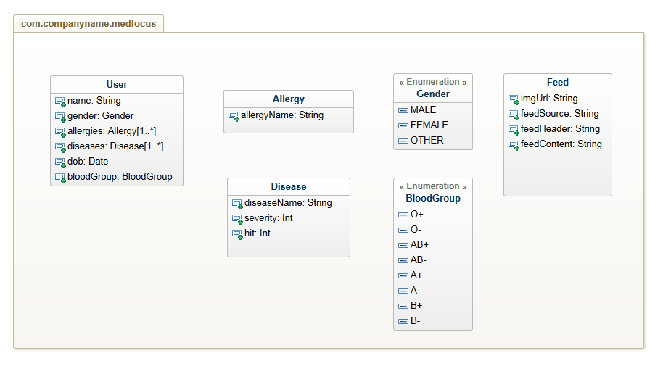
The model is kept simple to support dynamic data entries
This also reduces the complexity of the app and gives users more control over the data
Database - NoSQL Models and NoSQL objects are easily convertible
Notes:
Anything to add in the User class in this diagram?
Blood group da?
Mass da
Vera anything?

